Slide 1
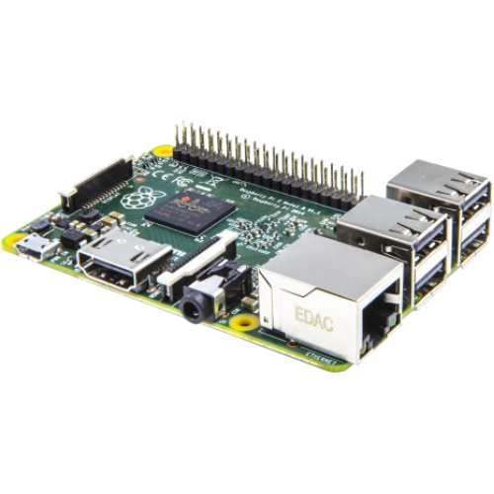
RaspberryPI GPIO Intro
Python + wires
Notes:
GPIO = “General Purpose Input/Output”
Each pin on a pi can be used as an input or an output
You can connect something like a LED to one of these pins. As an output you can turn on or off power to whatever is connected to it.
As an input you can detect when someone else turns the power on or off (like a switch) or a sensor
For this workshop we’ll be wiring up LED lights to GPIO pins, and demoing a high voltage relay, and maybe input switches if time permits

Slide 2


Dileshni Jayasinghe &
Marek Kudlacz
Notes:
- Dileshni works as a Platform Engineer at Unata
Uses python
Marek works at Oanda
Software Engineer / Architecture
Past worked involved OS, runtime, debugger development

Slide 3
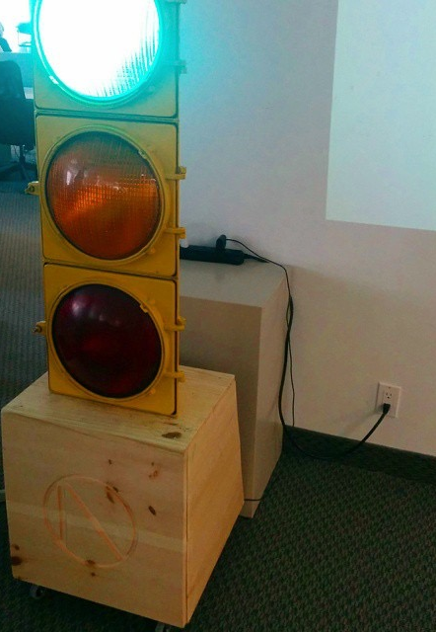
What we’re making…
Presentation Light & Timer
Notes:
Goal:
- Wire up LED Lights
- Use Python to control through GPIO Library
- Create console app to count down show red when the presenter is out of time.
- Show how to control lamps that use household AC (Alternating Current) power (show lamp)
We use this traffic light at Oanda for presentations and to show profit numbers for the day.
Green = profit, Yellow = Break even, Red = oh crap.

Slide 4
GPIO???
General Purpose Input/Output
Notes:
That giant row of pins you see on the RaspberryPI
Some provide power (+3.3V), Some provide ground (0V), Most are programmable to be able to read and send data.

Slide 5
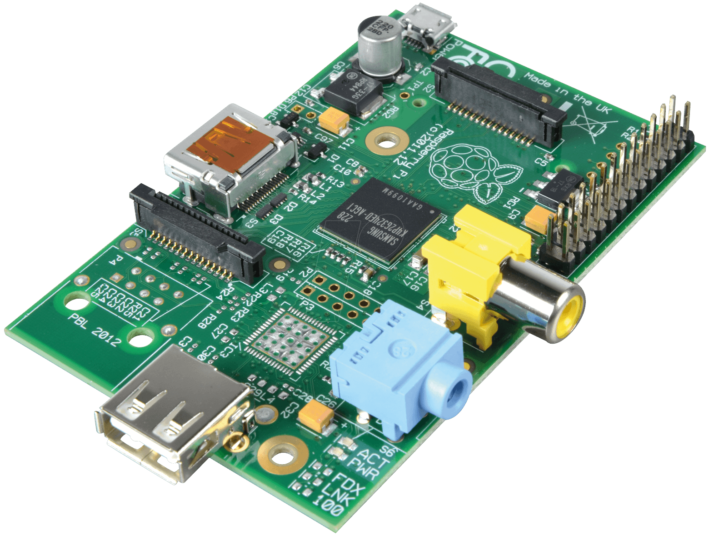
B+, RaspberryPi 2B
B, B (Rev 2)
Notes:
The red arrows are the GPIO pins.
If you ever assembled a computer, you know the connectors never stay the same for long. Every year there are new power connectors, cpu sockets, graphic card slots, ram slots.. etc because manufacturers change it.
There are 3ish versions of the GPIO pins depending on the pi model, because that’s how many revisions RaspberryPi foundation has released.
The models with the smaller set of pins have two different arrangements even though they look the same. (Explained in next slide)

Slide 6
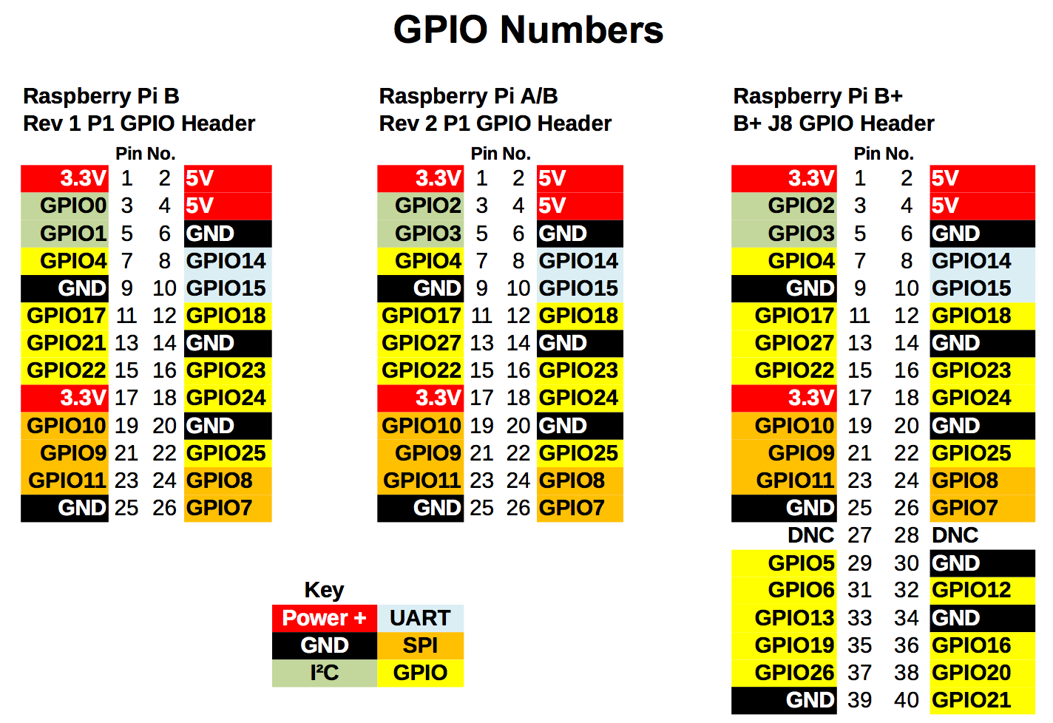
Notes:
We’ll provide printouts for you. So you have a reference.
These pictures are a diagram of each pin that you see on the pi and that pin’s purpose.
We’ll be using the Ground (GND/0V) pins and and the yellow GPIO pins (23, 24 25)
The ones marked Green, Orange, Blue are typically used when connecting to other devices like an SD Card reader. They were designed with a specific task in mind. For example the Green I2C ones have resistors built in, so the can safely be used as inputs (power coming in).
The yellow ones don’t have a specific purpose and can be used however you want as an input or an output.
Explanation of numbers next to ‘GPIO’ labels:
There are two ways to refer to the GPIO pins on a pi
First way is GPIO numbering as a computer sees them (GPIO23, GPIO24)… You might be wondering why the numbering jumps all over the place in no specific order.
Some GPIOs aren’t seen as a pin you can use. They are used by the PI to control components like its RAM, usb, graphics and ethernet port.
There is no easy way to remember them. You typically need to use a reference.
The second way is the physical number, by simply counting down the pin numbers. Pin #1 is at the top left.
For the purpose of this workshop, we’ll be using pins 16,18,20,22 because they are the same on every model.

Slide 7
Let’s get started!!
Finding out what version of the PI you have
Notes:
Long Row of pins = B+, Raspberry PI2
Short Row: v1 or v2

Slide 8
Run this command!
If you have a short row of pins.
sudo python
import RPi.GPIO as GPIO
GPIO.RPI_REVISION
0 = Compute Module, 1 = Rev 1, 2 = Rev 2, 3 = Model A+/B+/2
Notes:
You probably want to know which model of the pi you have.
First thing you need is Raspian (Pi foundation’s official Operating System) installed which we sent out as instructions for the workshop. It has python and everything you need preinstalled.
You then connect your pi to your computer.
Then open up the terminal and ssh into it the pi. (“ex. ssh pi@192.168.0.2”)
You can then run the command shown on the slide.

Slide 9


GPIO Pins + 5V =
Notes:
Warning: The GPIO pins can only work with 3.3V, if you’re ever working on a project, don’t accidentally connect it to the 5V pins. The PI has no built in protection.
The 5V pins are meant for powering components that might require them (sensors, motors) and they are provided as convenience. We don’t need them for this workshop.

Slide 10
Static =
Also…
Notes:
Touch something metal before touching your RaspBerryPI. Static electricity can damage your pi (and any electronics)
Touching metal discharges static off your body.
Static is more of a problem in the winter.

Slide 11
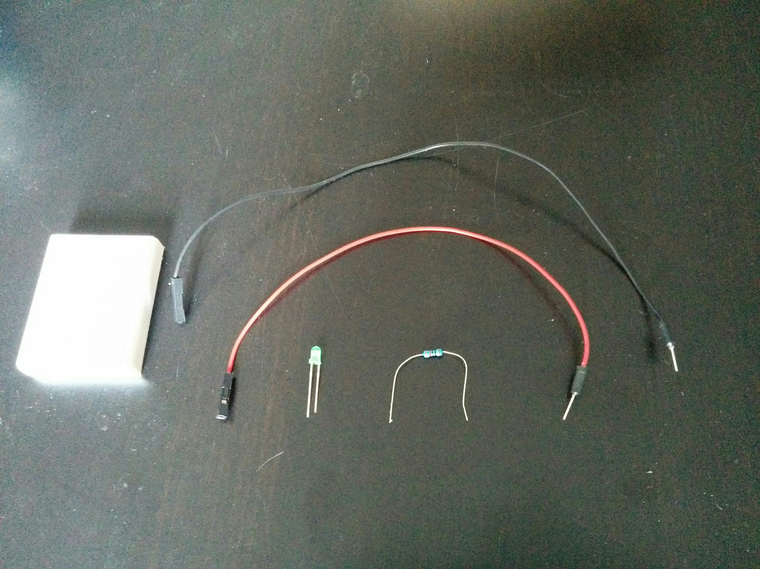
Grab these components…
Notes:
Breadboard
one LED light
one 220ohm resistor (they are all the same)
two wires

Slide 12
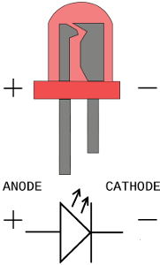
LED Light
The side with the longer leg connects to power
Otherwise
Notes:
LED lights only work in one direction.
Long leg connects to 3.3V (or GPIO output)
Short leg connects to ground.
Wiring it the wrong way might damage the LED and fry it.
If you have an LED that never seems to work, it might be fried.

Slide 13
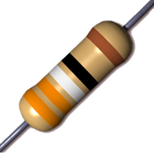
Resistor
3.3V can be too much for an LED
A LED can draw too much power for a GPIO pin
Notes:
Every component has strict power requirements.
GPIO pins’ limits are specified by makers of the RaspberryPI and it’s various components
the LEDs limits were set by the manufacturer.
We limit power usage and lower the voltage with a resistor.

Slide 14
Power Limits
The GPIO pins allow a max of 50mA of current for all pins
No one pin can use more than 10mA.
At full brightness these LEDs can use more than 10mA.
Balance brightness and power usage with the correct resistor.
Notes:
* sourced from somewhere on the raspberry pi website

Slide 15
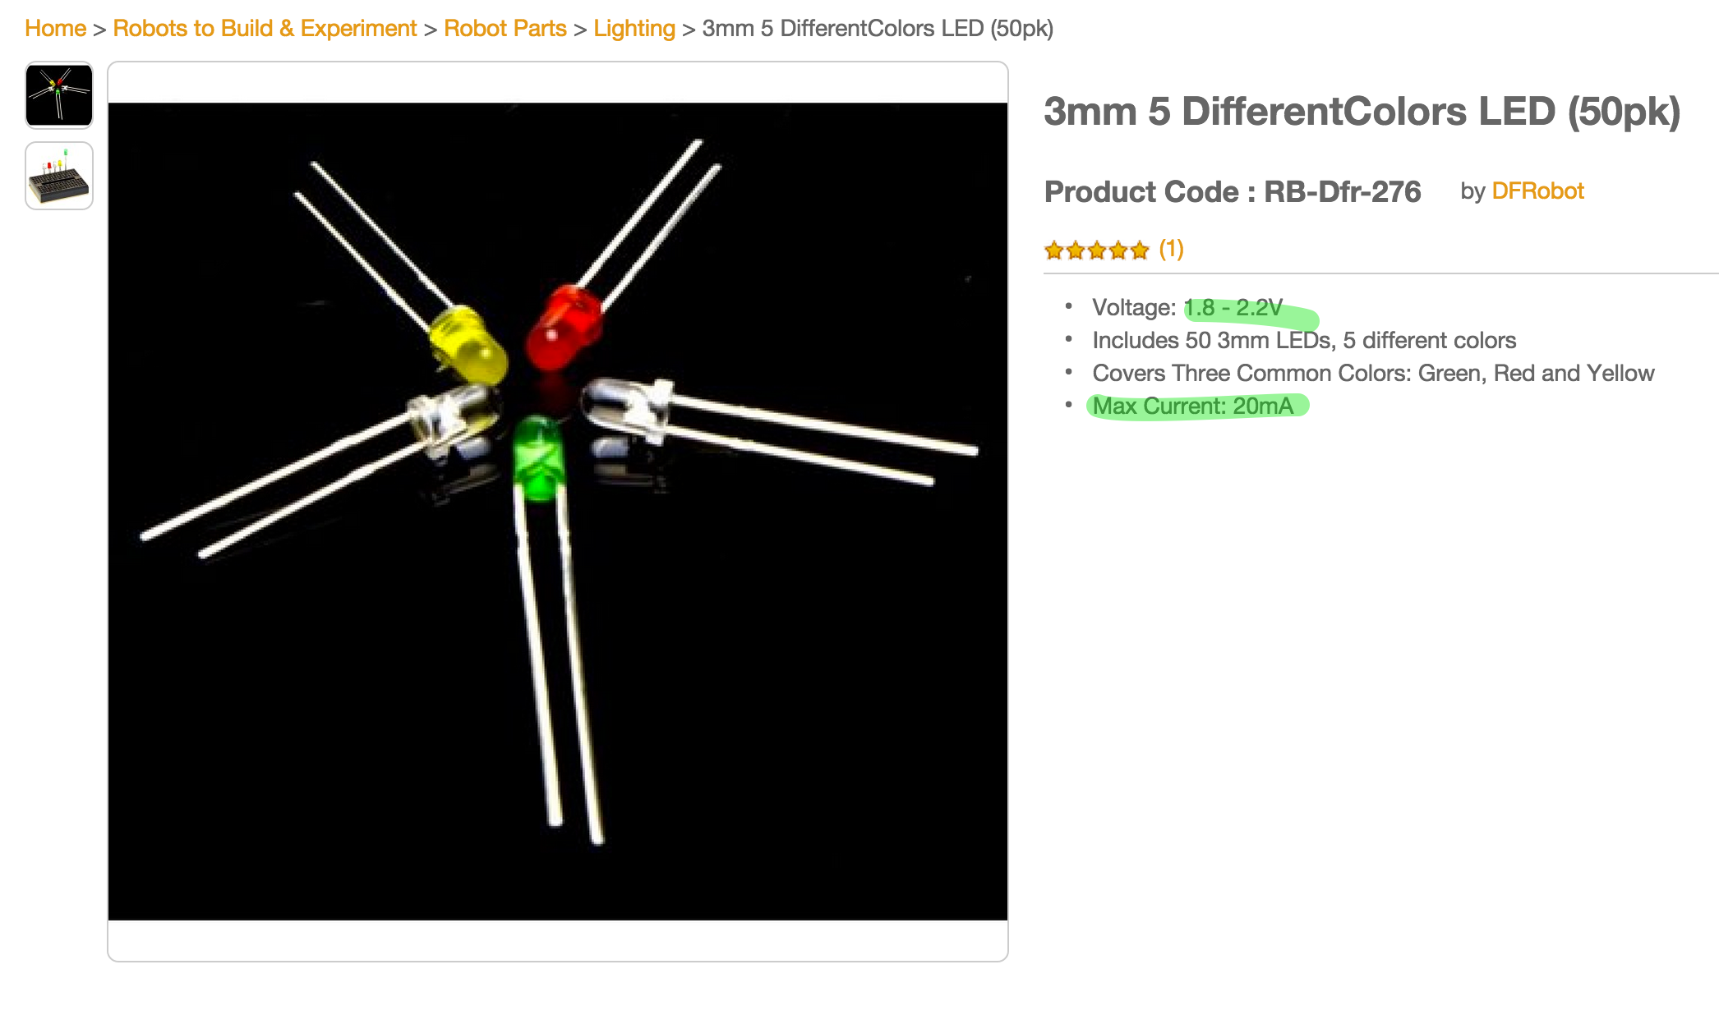
Notes:
A proper place should you specs for each LED light. Its max current (mA) at it’s ideal voltage.
Sadly this website (robotshop) listed a range of voltage, but it’s unclear what colour it’s for.
At least we know the max mA for the led. Well above a GPIO’s pins max.
The maximum current of 20mA listed above is too high for the GPIO pin. So we need to reduce it below 10mA using a resistor.

Slide 16
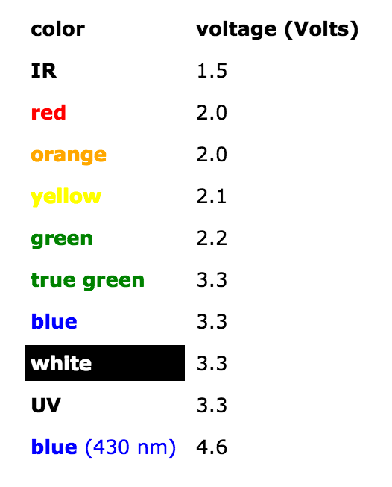
Notes:
Most simple LEDs have a standard maximum voltage they can safely run at. This voltage is also when they draw their maximum amount of power (20mA for the ones provided).
You can find charts like this online.

Slide 17
I = V / R
or
R = V / I
Ohm’s Law
Notes:
How do you find it?
Ohms Law
Current (Amps) = Voltage / Resistance (Ohms)
or
Resistance (Ohms) = Voltage / Current (Amps)
Voltage = strength of power
Current = how fast the power is flowing

Slide 18
R = V / I
R = (Source Voltage - LED Voltage) / ( mA / 1000)
R = (3.3 - 2.2)V / ( 5mA / 1000)
R = 1.1 V / 0.005 A
R = 220ohm
Resistance for Green LED
Notes:
Let’s try the green LED.
The Raspberry Pi can provide 3.3V
the green LED requires 2.2V (referring to slide 16)
the LED can have a max of 20mA of current before burning out.
the GPIO pin can have a max of 10mA of current before burning out.
So we need to get the current down below 10mA
Let’s play it safe and just aim for 5mA of current. 25% of what the LED can do. It won’t be at full brightness.

Slide 19
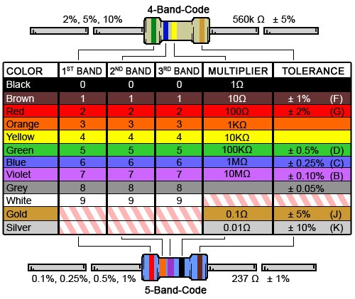
Resistor
You can figure out the resistance from the coloured bands.
http://www.digikey.ca/en/resources/conversion-calculators/conversion-calculator-resistor-color-code-4-band
Notes:
Or just when you order them don’t forget which ones which.

Slide 20
R = V / I
R = (Source Voltage - LED Voltage) / I
220ohm = (3.3 - 1.8)V / I
220 = 1.5 V / I
I = 220/1.5
I = 0.00681A
I = 6.81 mA
Resistance for Red LED
Notes:
If you recall each LED light required a different amount of power.
We don’t want to provide many different kind of resistors (cost)
Let’s see if we can use the same resistor for the other LED. let’s choose the Red one. The RED LED has the lowest voltage requirement.
Plugging in the other numbers, and solving for I (current), we can see that the red led will use 6.81mA using a 220ohm resistor.
Still within the limits we want (10mA). The brightness across each colour might be a bit inconsistent.

Slide 21
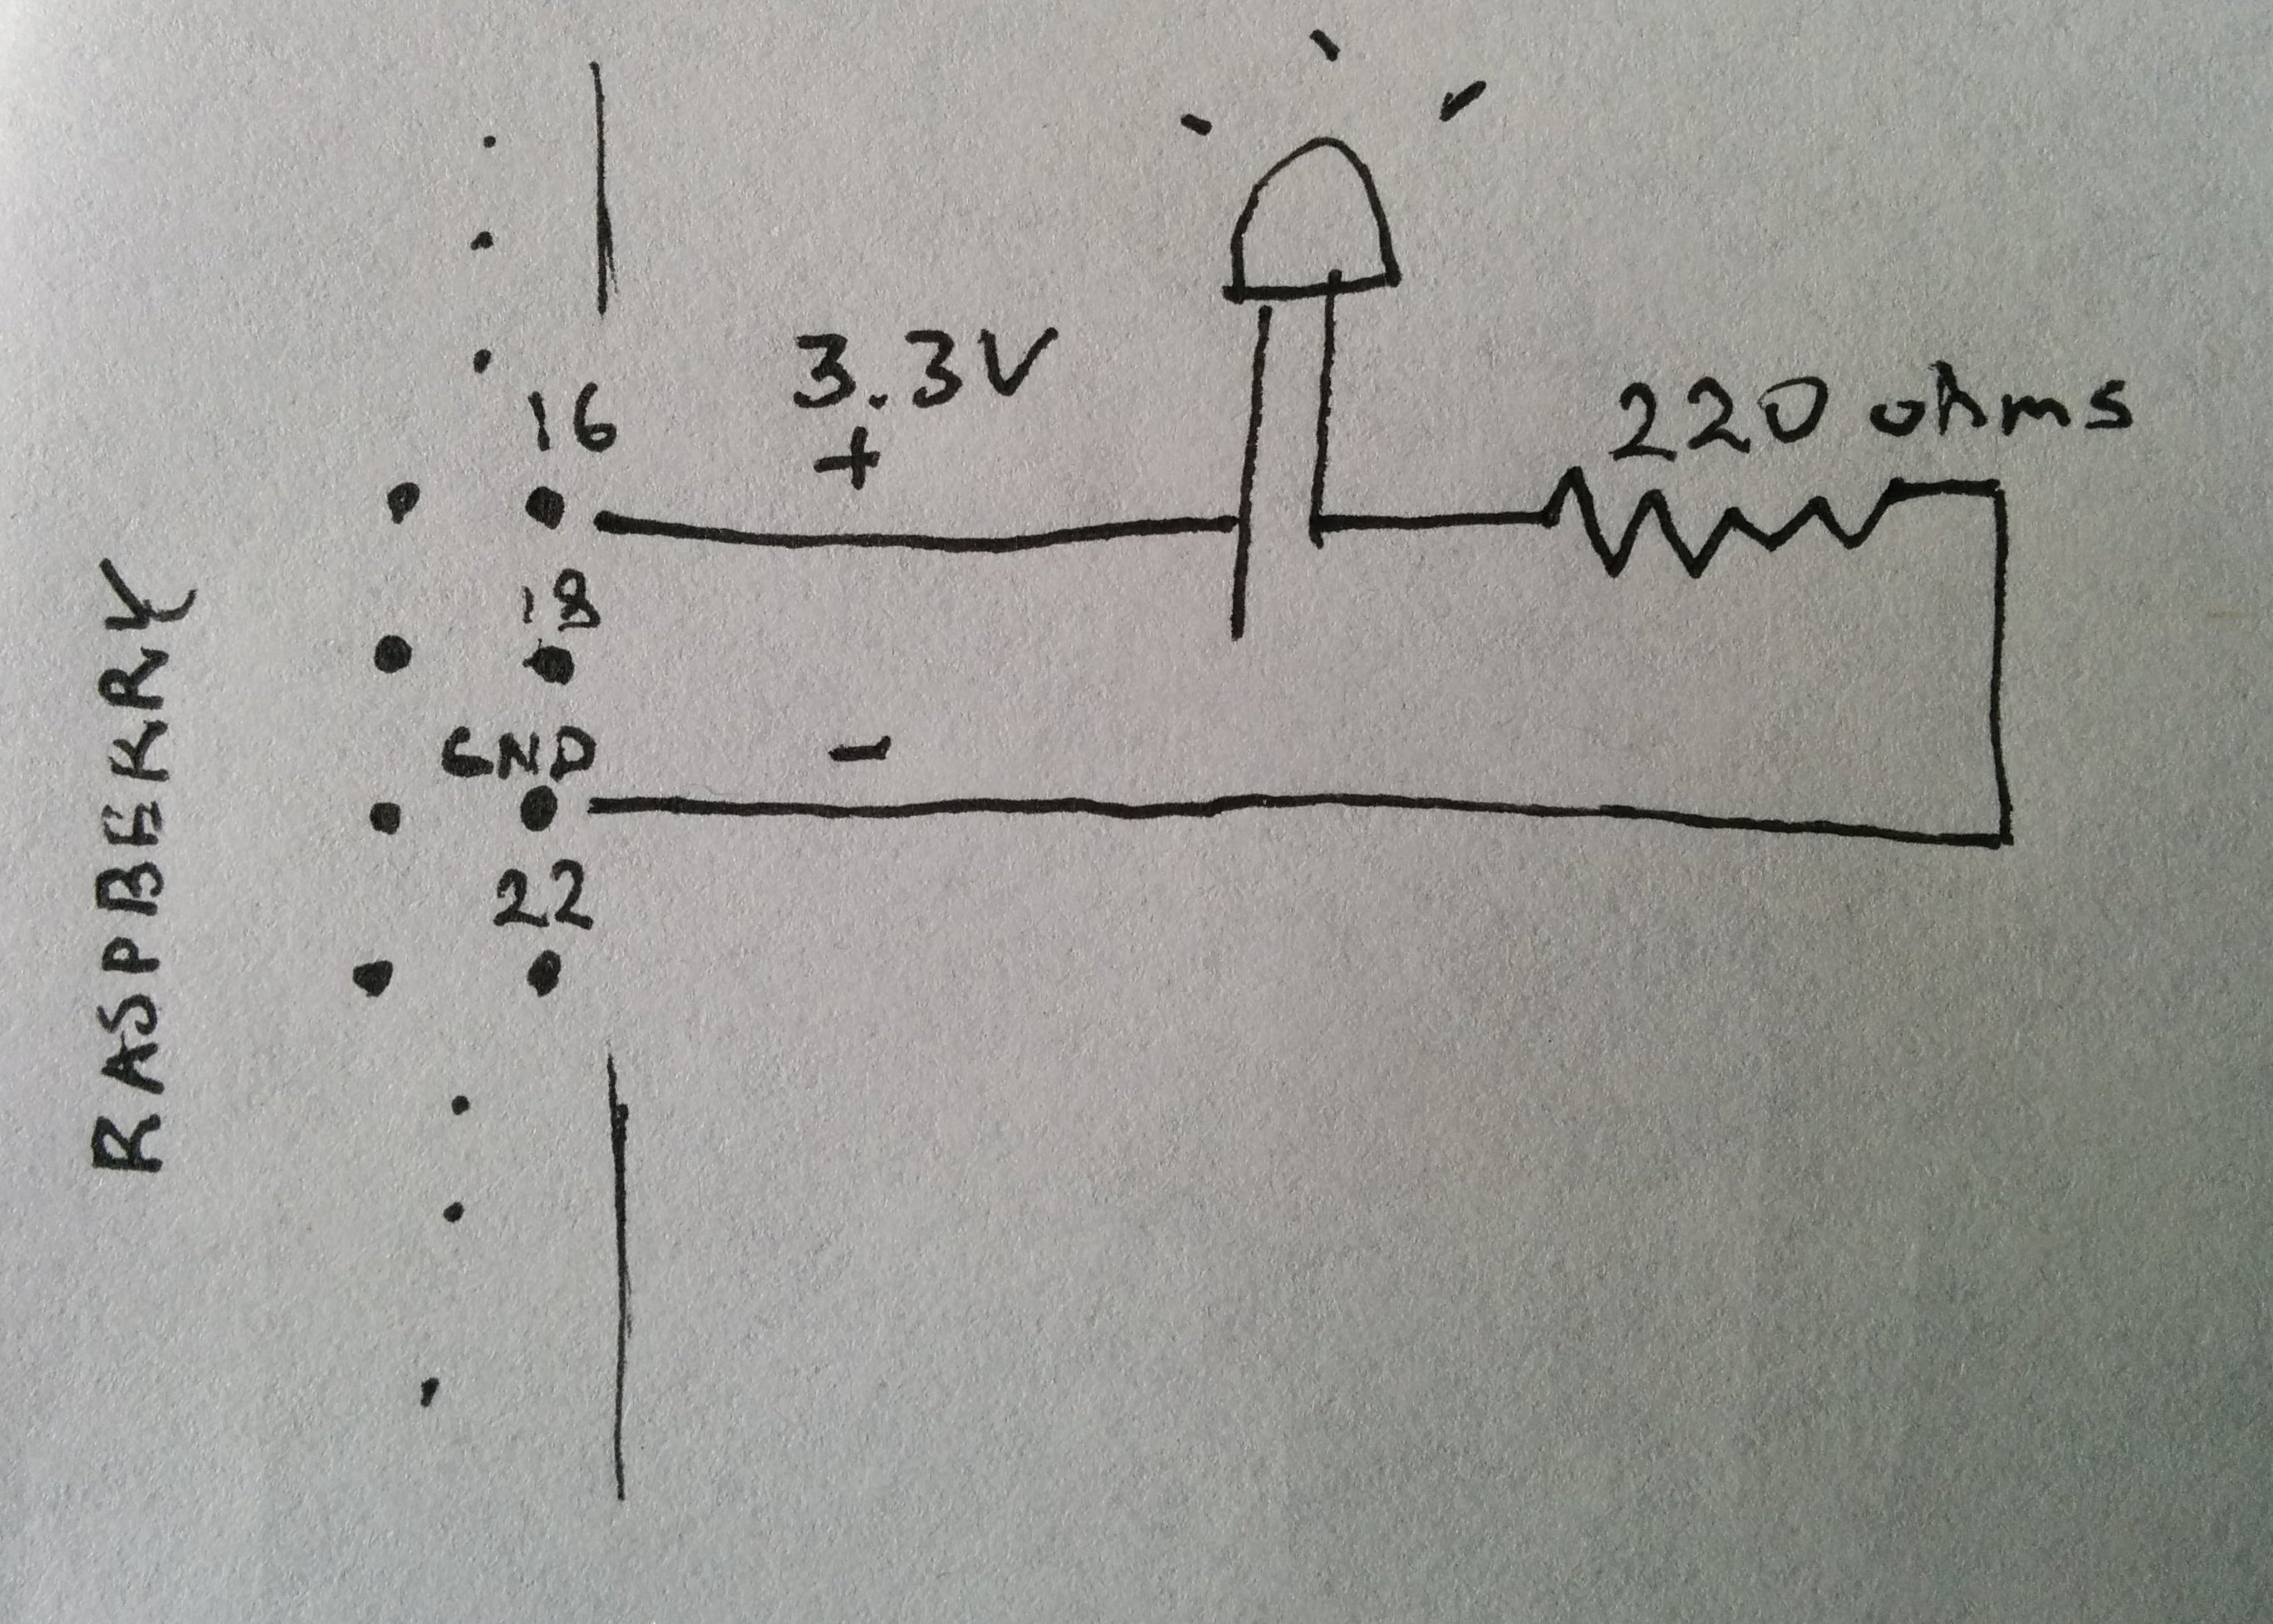
Notes:
Look at the breadboard horizontally.
Each column is connected together.
You can use the column to connect parts together.
- Take out a wire, connect GPIO 16 to the bread board.
Take the long leg of the led to the same column on the bread board.
Next you put the resistor to the column with the short LED leg.
Then take your next wire, connect it from the end of resistor to the raspberry pi’s ground pin.

Slide 22
Now to write some python
https://github.com/marek/lights
Notes:
We’re going to write code for one LED light to turn on/off once

Slide 23
Now repeat it 2x for the red and yellow LEDs.
Notes:
Use Pin 18 and 22 for the other two LEDs
Everything will need to be connected to ground.

Slide 24
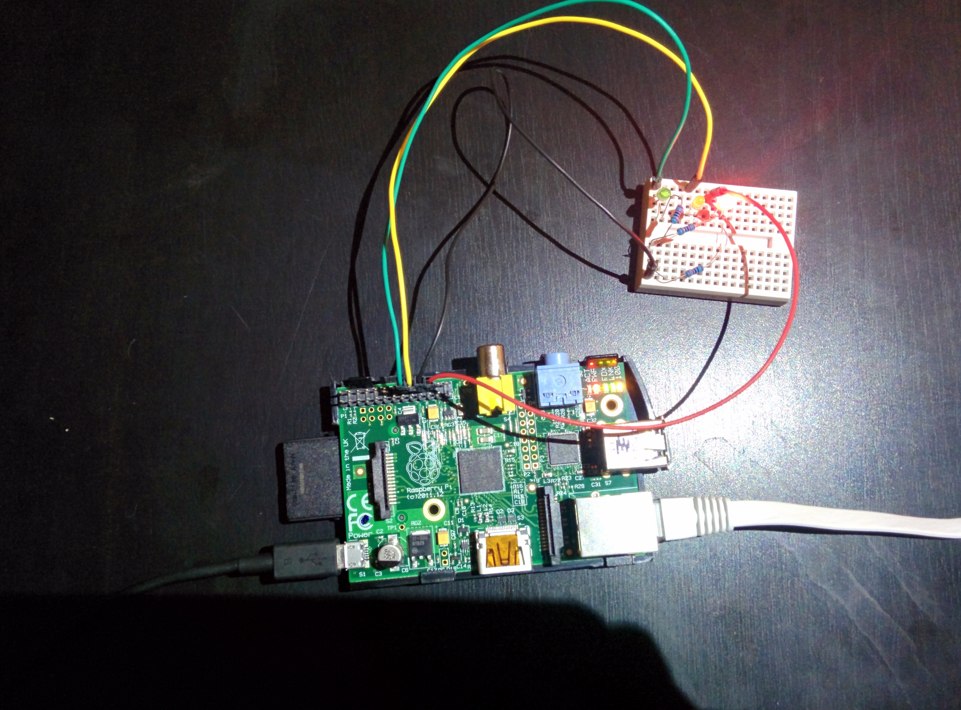
Notes:
example shot

Slide 25
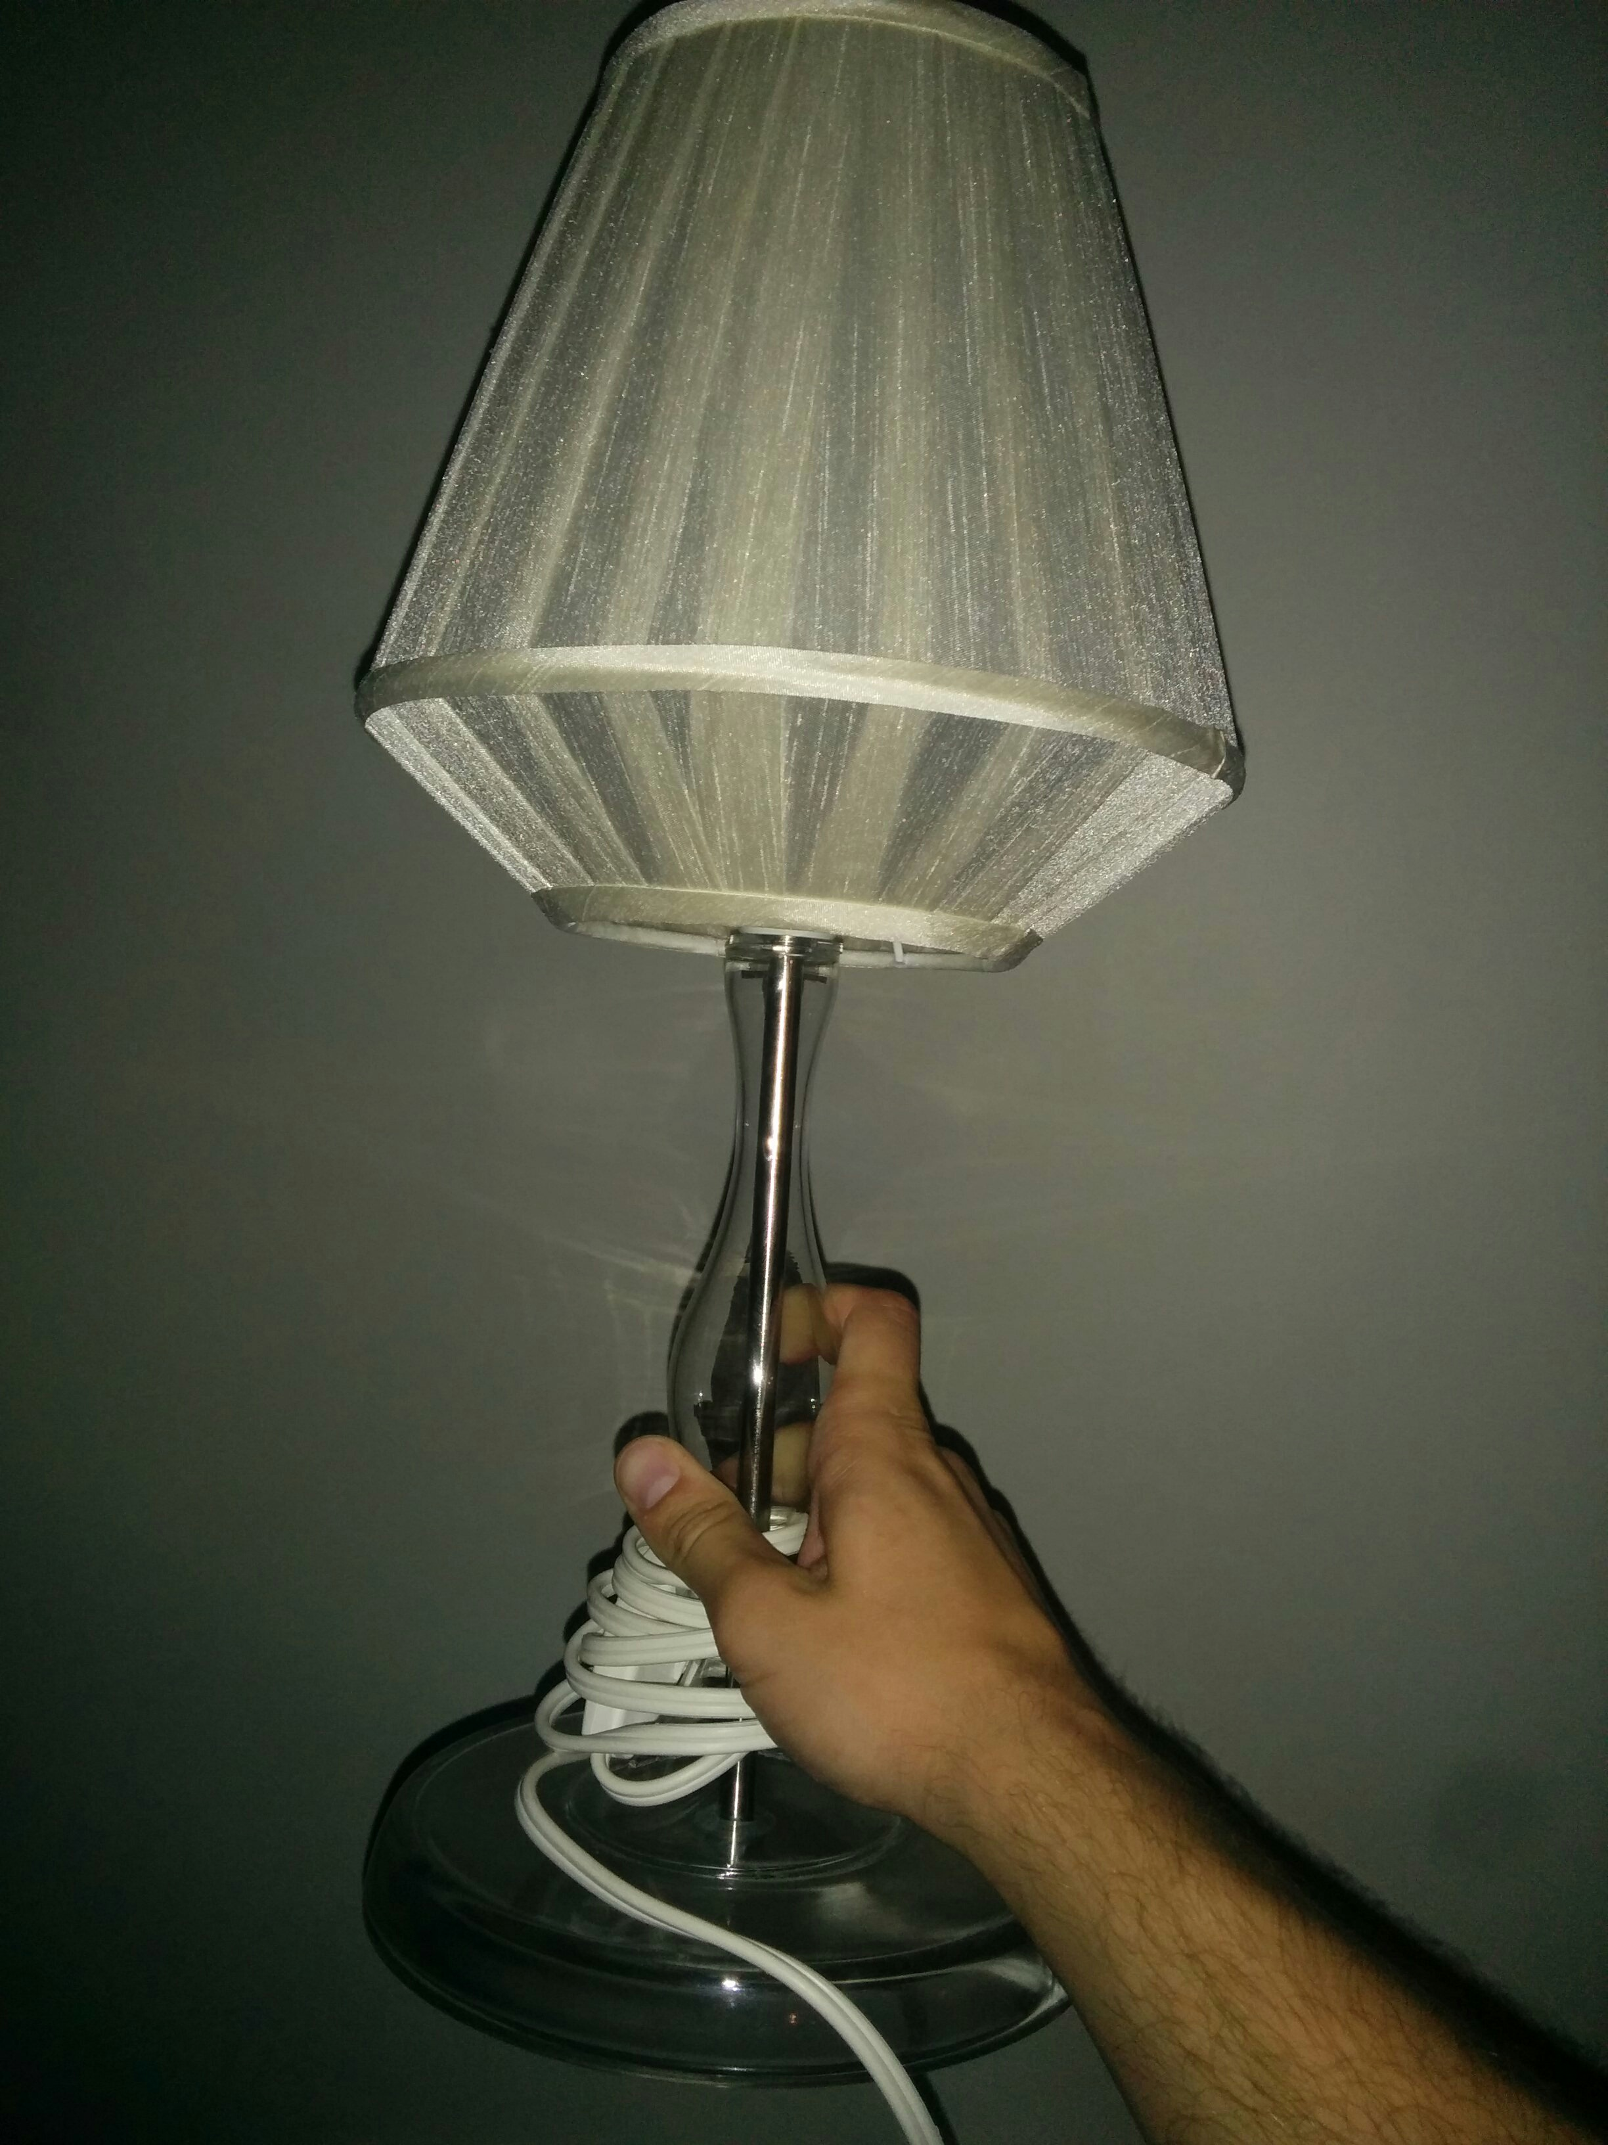
Notes:
Now lets control a desk lamp.

Slide 26
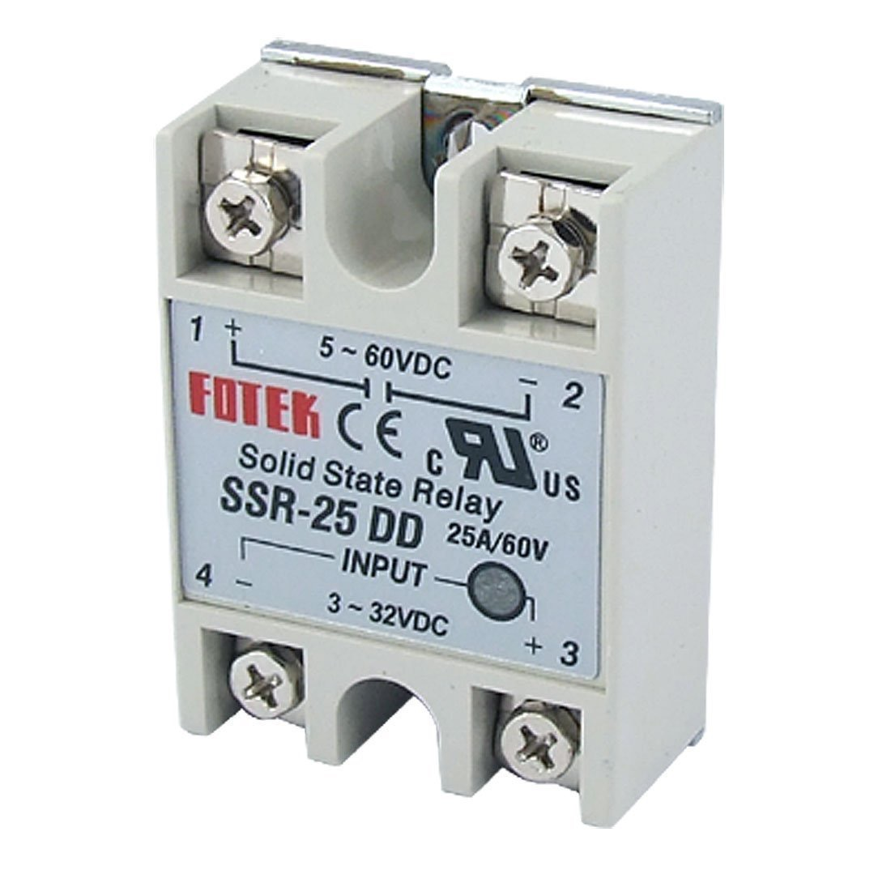
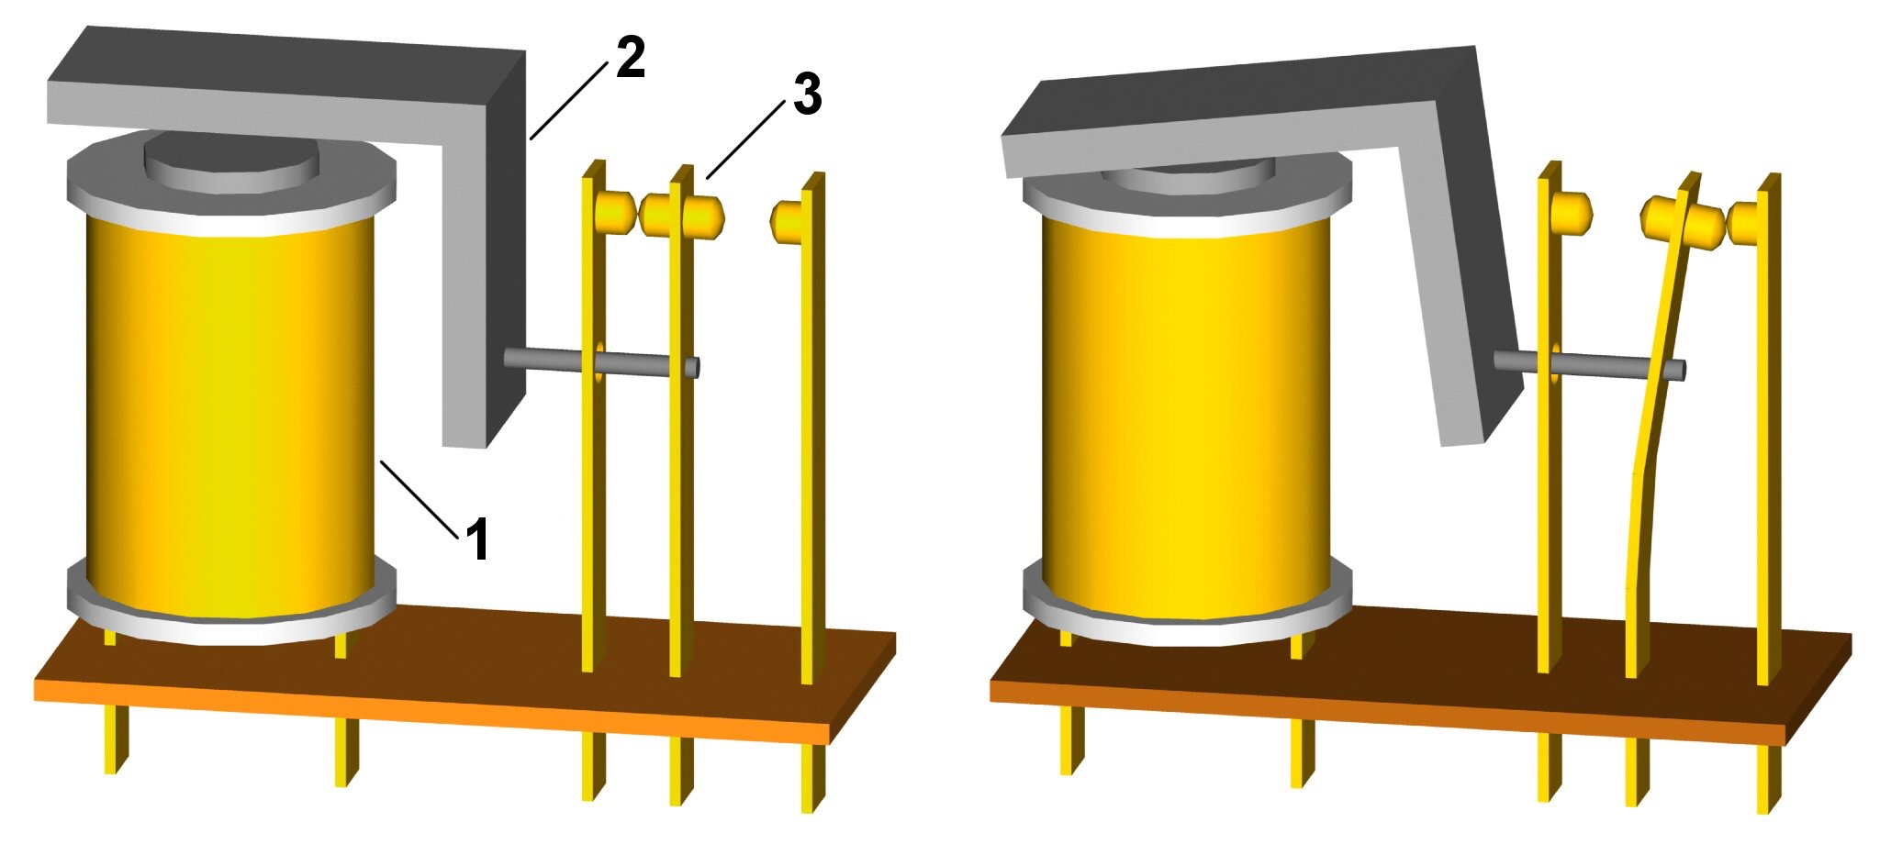
Using a Relay to control a lamp
Notes:
A relay is an an electronically controlled switch.
By providing power it will flip an internal switch and turn on something else.
Most have a magnetic switch inside that will close when you provide power
You’ll often here “clicking” in your car when you turn the key. That’s a relay.
Air conditions and furnaces work the same.
(The one for this workshop doesn’t have moving parts but they work the same)
FOTEK SSR-25 got it from aliexpress.com for ~$2.50 and waited a month
There are mechanical (moving parts) or solid state variants (uses transistors)
The relay will use slightly less than 10mA of power at 3.3V so it’s safe to use without a resistor.

Slide 27
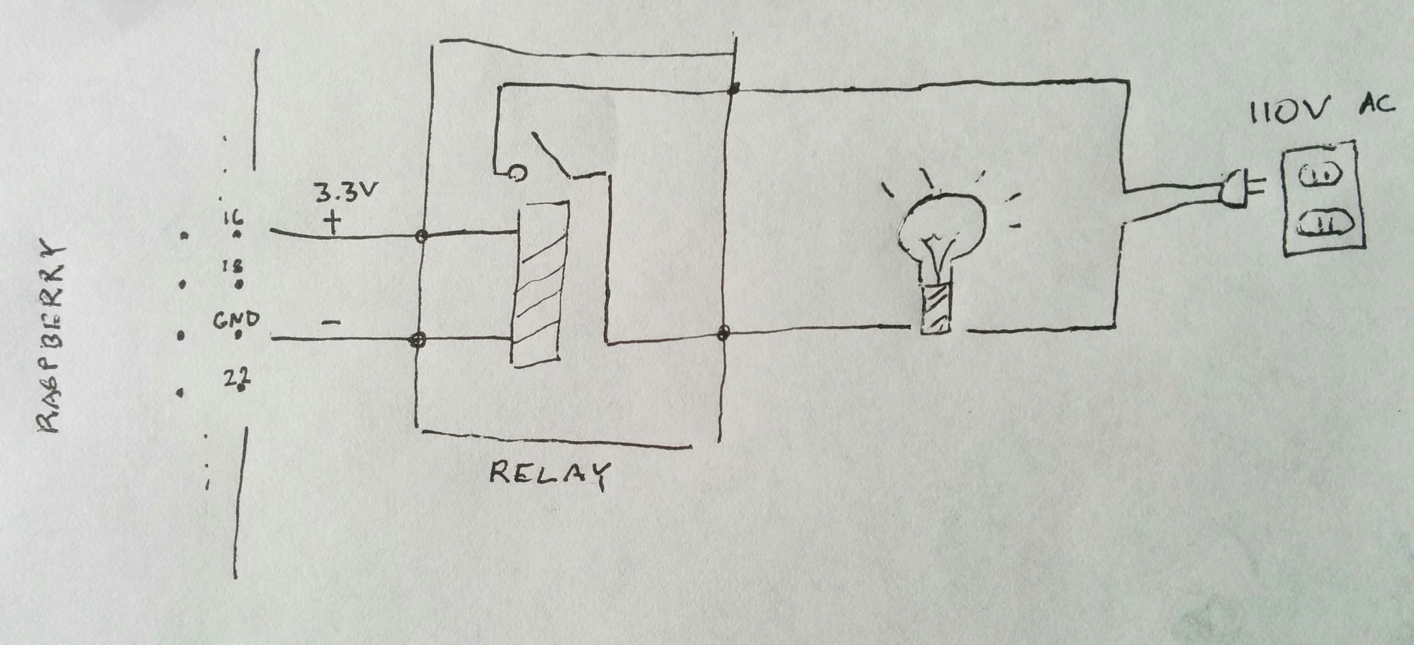
Notes:
We simply put the relay in place of one of the LED lights.
The other end of the relay is connected to a 110V AC circuit that the lamp is connected to.
The relay will then close (turn on) the AC circuit allowing the light to turn on.
You can now safely (as long as you don’t touch the relay) control a significantly higher voltage and different (AC rather than DC circuit) using your raspberry pi. and without damaging your pi or surpassing any if it’s power limits.

Slide 28
What else could you do?
Add buttons to reset the timer
Connect it to a giant traffic light
Control lights for halloween
Use a light sensor to automatically turn stuff on

Slide 29
Thanks!
Notes:
Thanks to fresh books, PyLadies and Marek for buying the supplies
Can you please return the breadboards.
You can buy them for a couple of dollars online (Amazon, Robotshop, Aliexpress)

